Slide 1
3D Computer Vision
Dr. Hassan Foroosh
School of EECS
UCF

Slide 2












Last time …
Points and lines
Conics and dual conics
Projective transformations

Slide 3
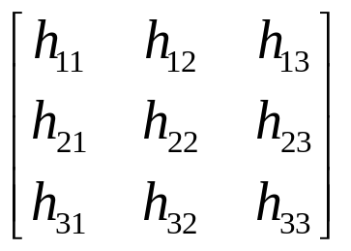
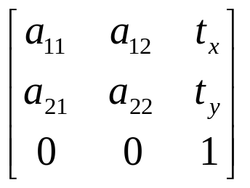
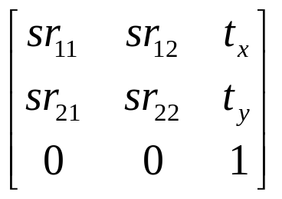
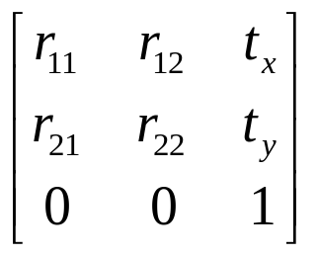
Last time…
Concurrency, collinearity, order of contact (intersection, tangency, inflection, etc.), cross ratio
Projective
8dof
Parallellism, ratio of areas, ratio of lengths on parallel lines (e.g midpoints), linear combinations of vectors (centroids).
The line at infinity l∞
Affine
6dof
Similarity
4dof
Ratios of lengths, angles.
The circular points I,J
Euclidean
3dof
lengths, areas.

Slide 4



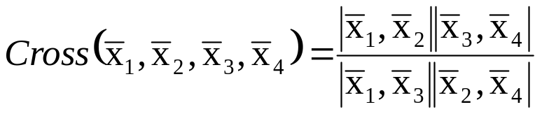
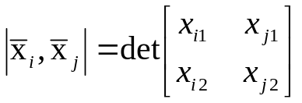
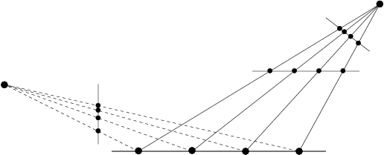
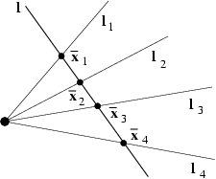
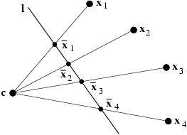
Projective geometry of 1D
3DOF (2x2-1)
The cross ratio
Invariant under projective transformations

Slide 5
Recovering metric and affine properties from images
Parallelism
Parallel length ratios
Angles
Length ratios

Slide 6
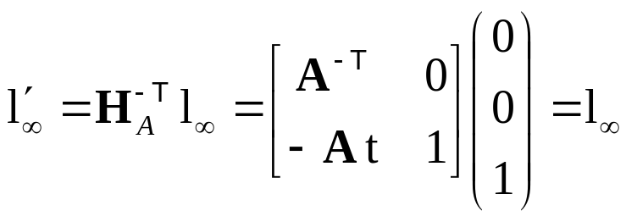
The line at infinity
The line at infinity l∞ is a fixed line under a projective transformation H if and only if H is an affinity
Note: not fixed pointwise

Slide 7
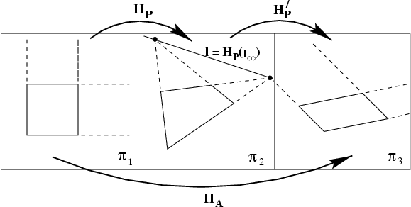
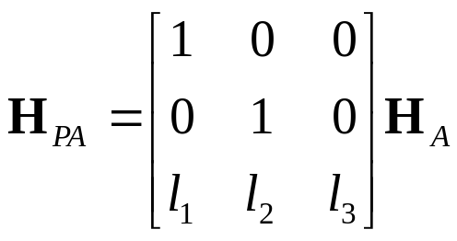

Affine properties from images
projection
rectification

Slide 8
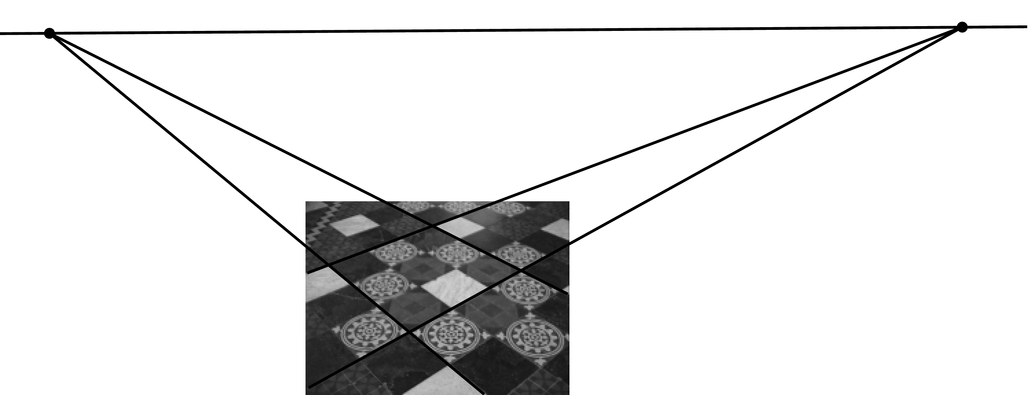



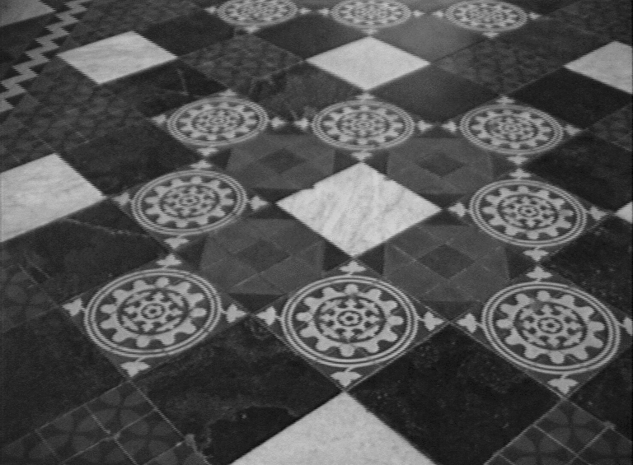
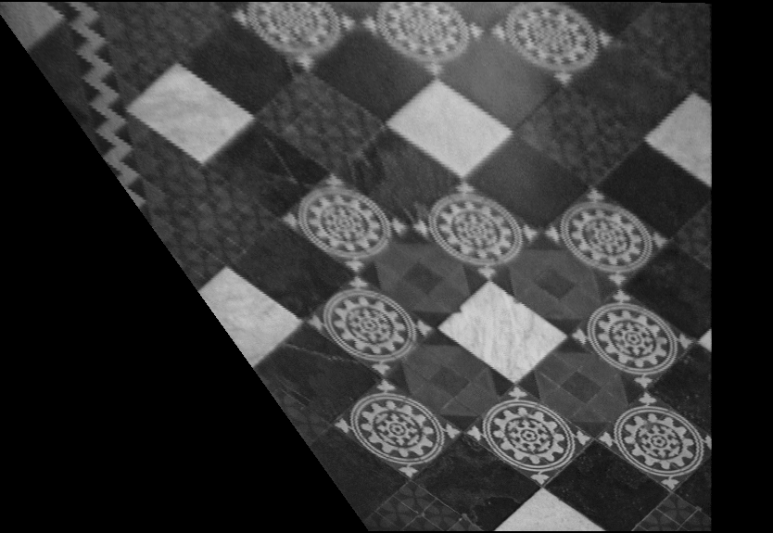
Affine rectification
v₁
l∞
v₂
l₁
l₃
l₂
l₄

Slide 9
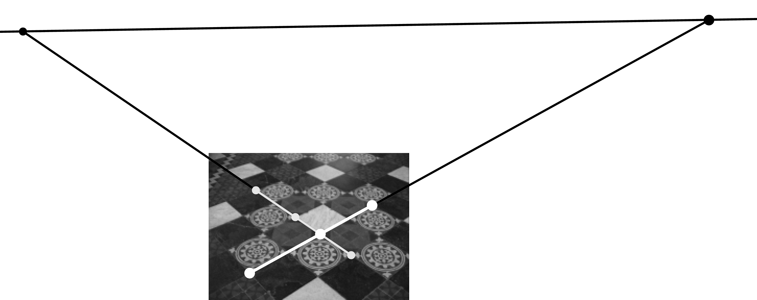


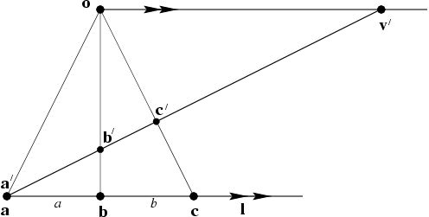



Distance ratios

Slide 10
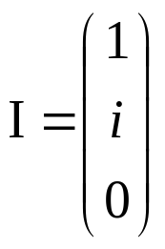
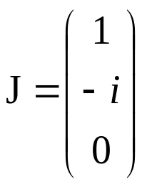
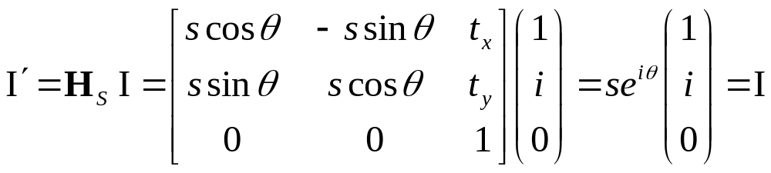
The circular points
The circular points I, J are fixed points under the projective transformation H iff H is a similarity

Slide 11
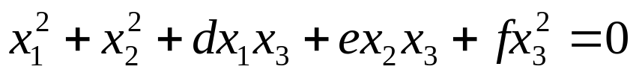
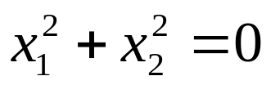
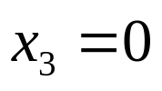
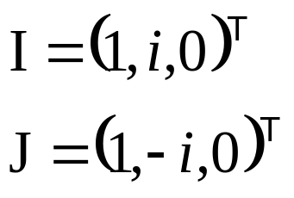
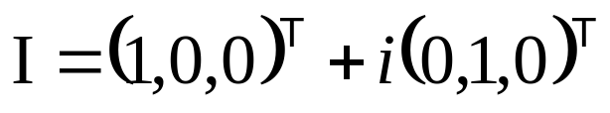
The circular points
“circular points”
l∞
Algebraically, encodes orthogonal directions

